Slide 1
Conference Paper Recommendation System using LSH
TEAM 8
Parineeta Kishore Patil (013829114)
Steffin Franklin (013814996)
Sum Mohan Reddy (014545453)
Swetha Shiva Shankar Reddy (013829153)

Slide 2
Overview
INTRODUCTION
DATASET
DATA INPUT
PREPROCESSING
FRAMEWORK AND APPROACH
ANALYSIS AND EVALUATION
CONCLUSION AND FUTURE WORK
REFERENCES

Slide 3
INTRODUCTION
Recommender systems help the users to get personalized recommendations and redefine the users web browsing experience.
With the growth of scientific publications, conference paper recommendations based on browsed topics can benefit researchers to find relevant papers easily.
As the data is large, a faster and scalable algorithm is required.
Hence, LSH is used as a criterion to find the similarity between conference papers.

Slide 4
DATASET
IEEE conference papers on Computer Vision and Pattern from Kaggle.
Dataset contains 1294 accepted papers of 4.5 GB in size.
Source: https://www.kaggle.com/paultimothymooney/cvpr-2019-papers

Slide 5
PREPROCESSING
Data Preprocessing is done using the regular expressions (re) and the natural language tool-kit (nltk ) library in python.
1. Lowercase all text.
2. Remove all digits.
3. Remove all punctuations.
4. Removing stop words.
5. Lemmatization (Stemming).

Slide 6
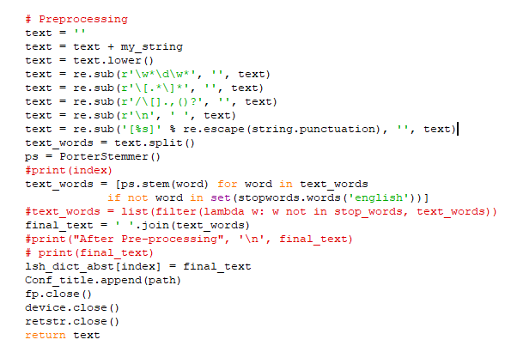

Slide 7
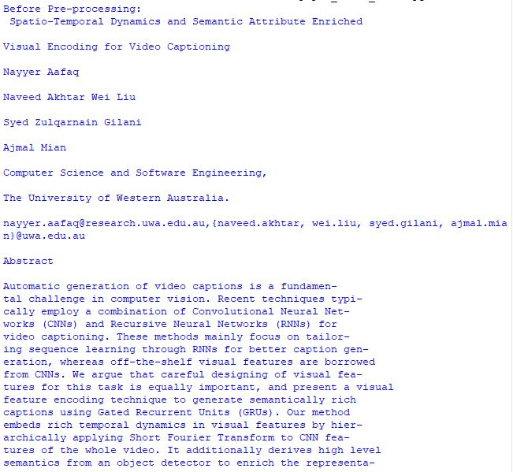
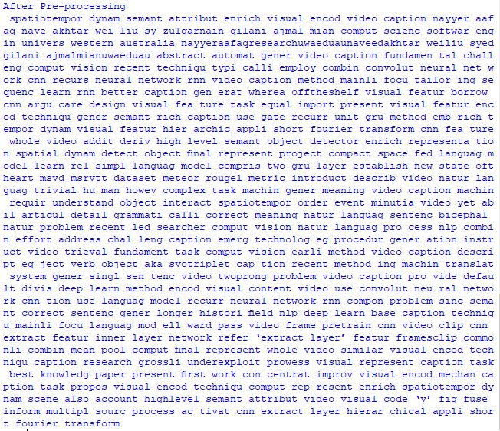

Slide 8
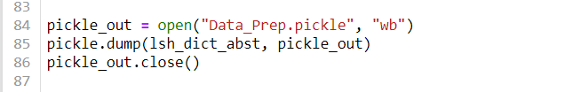
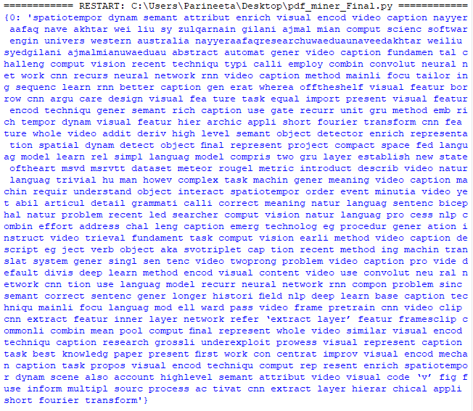
DATA INPUT

Slide 9
FRAMEWORK AND APPROACH
Reading the document data as a single dictionary
Key : Doc_id ; Value : List Doc_text
Converting the document into a set of k-shingles
Shingles in Docs = set ( )
Generate Minhash Signatures
shingleIDSet = docAsShingleSets[docID]
Signature = [ ]

Slide 10
FRAMEWORK AND APPROACH - cont.
4. Compute True Jaccard Similarity and find top-n similar documents.
5. Compute Estimated Jaccard Similarity using the Signature Matrix and find top-n similar documents.
6. Compare the recommendations provided by True and estimated Jaccard Similarity.
7. In LSH, we find appropriate b and r values to find most similar pair of documents..
8. Obtain TP and FP values to evaluate LSH.

Slide 11
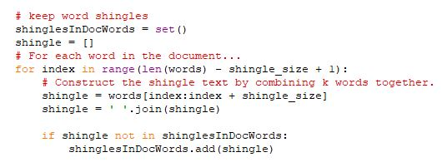
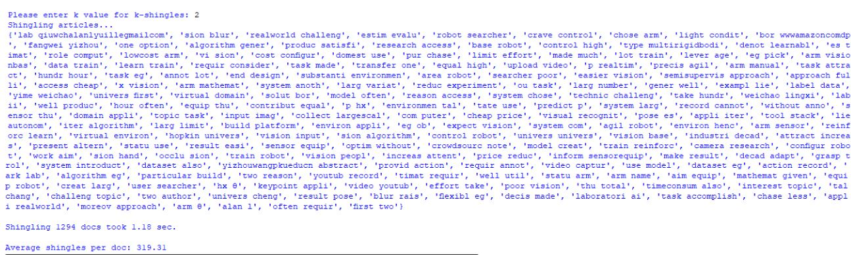
SHINGLING

Slide 12
MinHashing
MinHashing includes
Generate a set of random hash functions of the form:
h(x) = (a*x + b) % p
where 'x' is the input value, 'a' and 'b' are random coefficients, and 'p' is a prime number just greater than number of shingles.
Used Miller Rabin Primality Test to find the value of p.
Compute Signature matrix.

Slide 13
Miller Rabin Primality Test
The Miller–Rabin primality test or Rabin–Miller primality test is a primality test: an algorithm which determines whether a given number is prime
(n-1) = 2^{k} * m
a: 1 < a< (n-1)
b₀ = a^{m} mod n , b_{i} = (b_{i-1} )²
If b₀ = +1 or -1 , it is probably prime
If b₁ = +1, It is composite. If -1 it is prime

Slide 14
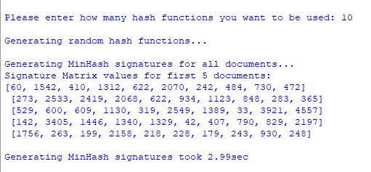

Slide 15
LSH
Divide the signature matrix into “b” bands
Perform hashing with a hash table of buckets
Generate candidate pairs that hash to the same bucket
Repeat the process by tuning “b” and “r” values to get the most similar pair of documents

Slide 16
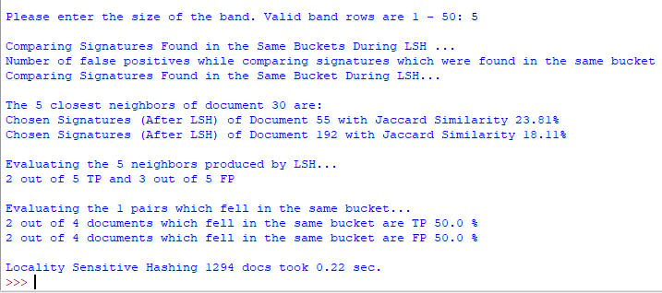

Slide 17
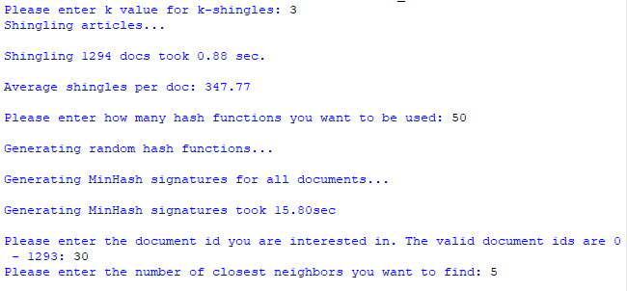
EVALUATION

Slide 18
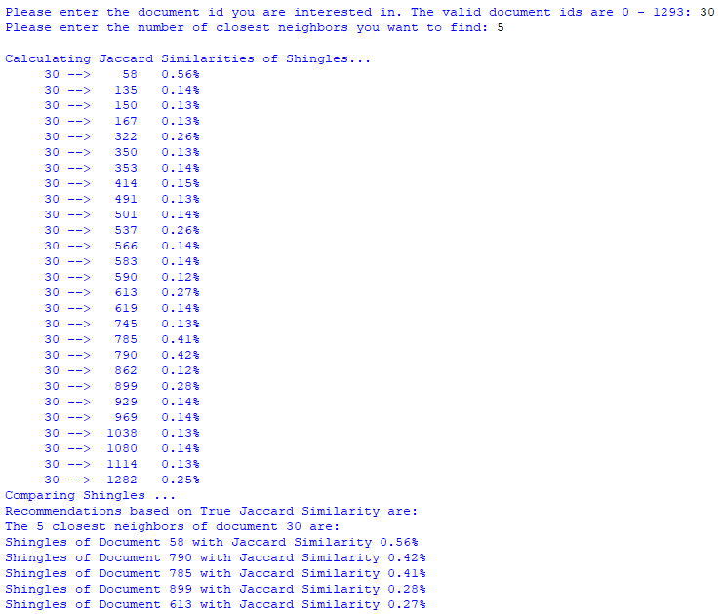
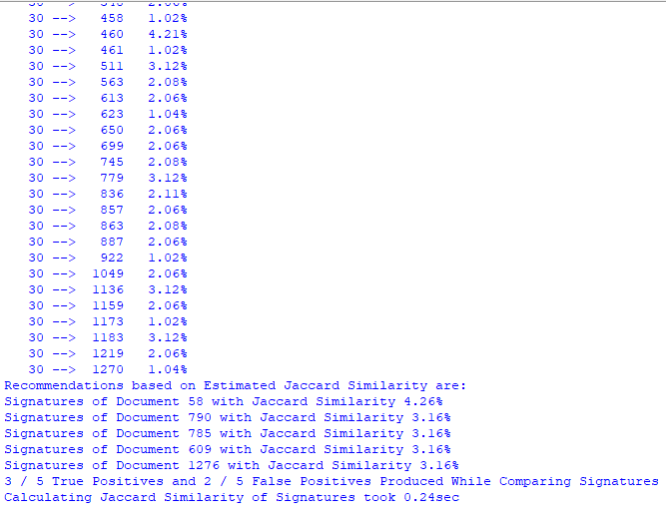

Slide 19
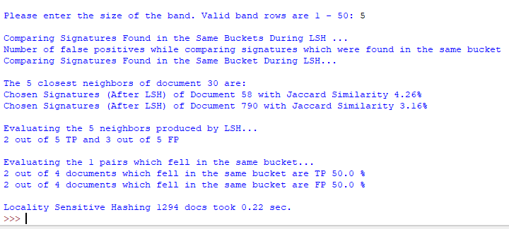

Slide 20
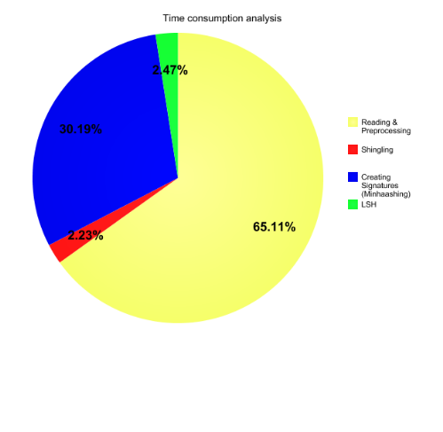
Time consumption

Slide 21
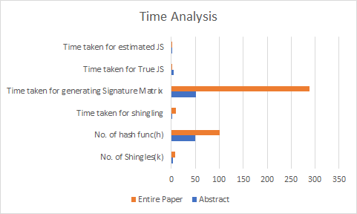
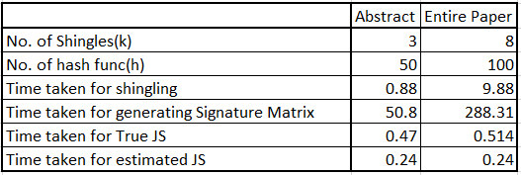
ANALYSIS

Slide 22
CHALLENGES AND ENHANCEMENTS
Challenges
To find the appropriate shingle value “k”
To find the appropriate number of hash functions to generate Min-hash signatures.
Tuning parameters for LSH is a tedious process as its a trial and error process.
Enhancements:
As tuning is a tedious process we move to Multi-probe LSH.
Ultimately the results rely on user satisfaction on how relevant the papers are to the user so the system can be tested on this parameter to measure the true accuracy of the recommender system.

Slide 23
REFERENCES
[1] https://www.learndatasci.com/tutorials/building-recommendation-engine-locality-sensitive-hashing-lsh-python/
[2] https://link.springer.com/article/10.1007/s10844-019-00552-1
[3] https://towardsdatascience.com/locality-sensitive-hashing-for-music-search-f2f1940ace23
[4] https://www.datacamp.com/community/news/recommendations-with-locality-sensitive-hashing-lsh-i-mac41tvory
[5] https://github.com/pcharishma/Movie-Recommendations-using-LSH
[6] A. Smirnov and A. Ponomarev, "A hybrid peer-to-peer recommendation system architecture based on locality-sensitive hashing," Proceedings of 15th Conference of Open Innovations Association FRUCT, St. Petersburg, 2014, pp. 119-125, doi: 10.1109/FRUCT.2014.6872418.
[7] A. M. Aytekin and T. Aytekin, "Locality sensitive hashing based scalable collaborative filtering," 2015 23nd Signal Processing and Communications Applications Conference (SIU), Malatya, 2015, pp. 1030-1033, doi: 10.1109/SIU.2015.7130008.
[8] http://hdl.handle.net/10125/49985

Slide 24


